Slide 1
Factors of attractiveness of Russia manufacturing to foreign investors
HIGHER SCHOOL OF ECONOMICS
National Research University
Student: Dudko V. V.
Group: 41 MMEA
Argument consultant: Ratnikova T. A.
Language consultant: Sokolinskaya T. V.

Slide 2
The object of the study
Investment – the crucial part of aggregated demand and determinant of economic growth.
Investment:
Portfolio investment - investment made by investors who are not particularly interested in involvement in the management of a company.
Direct investment - the net inflows of investment to acquire a lasting management interest (10 per cent or more of voting stock) in an enterprise operating in an economy other than that of the investor.

Slide 3
Russian black metallurgical sector characteristics
2008: Russia – the 4th world steel producer;
Rapidly growing sector in 2001-2008: 16% annually;
Export-oriented industry: 30-40% of production is exported;
High vertical integration and concentration: 6-7 companies account for 75% of steel production.
The sector was heavily affected by the crisis of 2008-2010: capacity utilization rate of major companies declined to 50-60%.
Graph: RTS Metals index performance
Source: FINAM

Slide 4
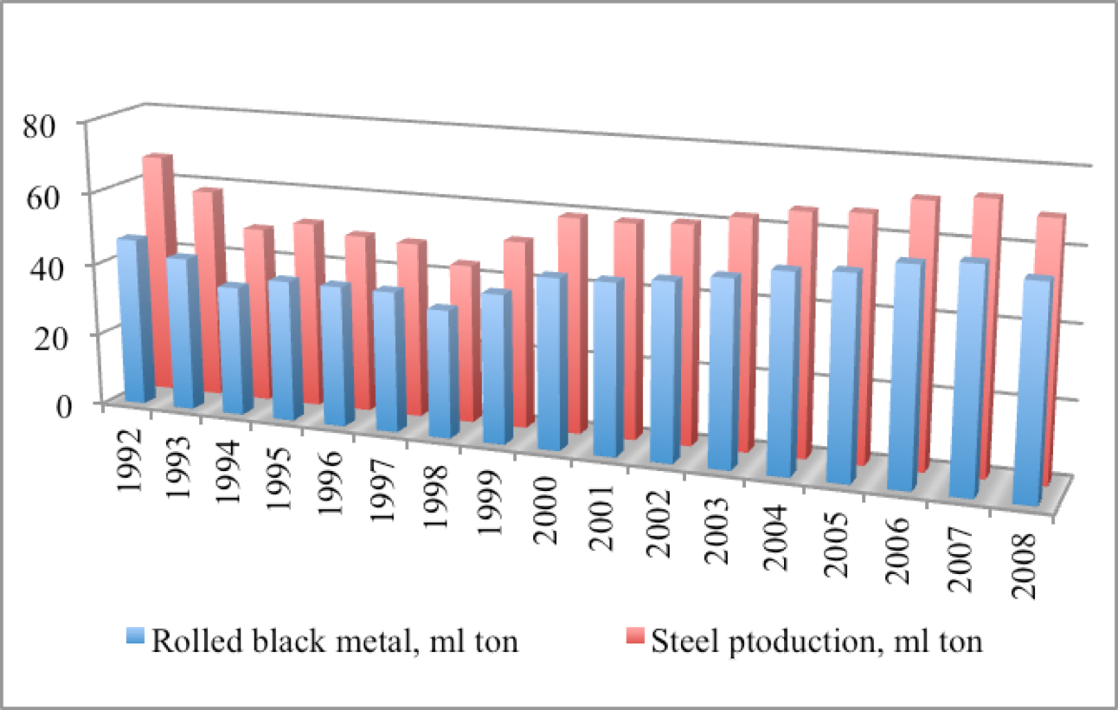
Russian black metallurgical sector characteristics
Graph: Investment in fixed capital of Russian metallurgical sector
Source: Rosstat
Graph: Investment in fixed capital of Russian metallurgical sector
Source: Rosstat

Slide 5
Literature review
Determinants or FDI:
state and regional characteristics
technical capabilities characteristics
firm characteristics
Knowledge seeking hypothesis - searching of capabilities that are not available in their home markets.
Market characteristics;
Firm characteristics;
Institutional factors;
Agglomeration effect - benefits, savings or cost reductions resulting from the clustering of activities.

Slide 6
Model specification
Firm-level data for several years (2000-2007) - panel dataset;
Percentage of foreign investors ownership in the company’s capital - interpreted as probability of FDI;
Econometric models:
Multinomial logit model (dependent variables – characteristics of individuals);
Conditional logit model (dependent variables – characteristics of alternatives);
Probit models (fixed effect, random effect).

Slide 7
Data availability
Bureau Van Dijk – an international agency providing databases of individual companies, countries, regions and global information and business intelligence for individual countries, regions and the world.
The global database covers around 100 million companies.
“Ruslana” database:
Financial indicators,
Beneficiaries of the business,
Stock trades (for public companies).

Slide 8
Thank you for your attention!

